Slide 1




Lecture: 6
SOCIAL MOVEMENT & CIVIC RESPONSIBILITY

Slide 2
•SOCIAL MOVEMENTS:
Social movements are collective, organized efforts by individuals or groups to bring about social, political, or cultural change. They emerge in response to perceived injustices or unmet needs within society and can aim for reform (changing specific policies) or radical change (overhauling societal structures).
•Examples:
•Civil Rights Movement (1950s-1960s, United States)
•Women’s Suffrage Movement (Late 19th - Early 20th Century)
Environmental Movement (1960s - Present)

Slide 3

CIVIC RESPONSIBILITY:
Civic responsibility refers to the duties and obligations of individuals to be active, participative members of their communities. It includes a commitment to contribute to societal well-being, foster democratic processes, and maintain social order.
•Examples:
•Voting in Elections
•Volunteering
Advocating for Community Issues

Slide 4
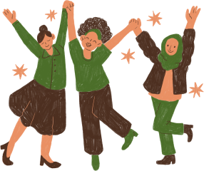
ROLE OF SOCIAL MOVEMENTS IN DRIVING SOCIAL CHANGE
Social movements play a critical role in driving social change by raising awareness, mobilizing collective action, and influencing public policy.
These movements emerge when individuals or groups recognize injustices or inequalities and unite to advocate for reform.
Social movements influence policy changes by pressuring governments and institutions to enact laws and regulations addressing the movement's objectives.

Slide 5

They empower individuals to engage in civic activities, enhancing participation in democratic processes and encouraging active citizenship.
Social movements provide a platform for innovation in social practices, creating alternative approaches to education, health, and welfare that may eventually be adopted broadly.
Social movements challenge and reshape cultural norms, often shifting public opinion on issues like gender equality, environmental protection, or human rights.
Social movements catalyze international collaboration by linking with global issues, encouraging transnational support, and aligning efforts across borders.

Slide 6
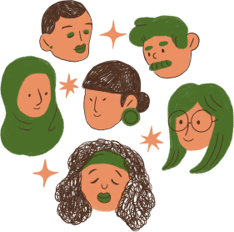
CIVIC ISSUES
Social movements play a vital role in driving social change, especially regarding civic issues, by mobilizing individuals and communities to address shared concerns and advocate for reform. Here's how they contribute to advancing civic issues:
1) Advancing Voter Rights and Participation: Social movements highlight the importance of fair voting practices, advocating for accessible polling locations, anti-discrimination measures, and voter education programs to strengthen democratic participation.

Slide 7
2) Promoting Racial and Social Justice: Movements like Black Lives Matter have brought global attention to racial inequality, encouraging policy reforms, promoting justice for marginalized groups, and fostering public discussions on equality and discrimination.
3) Advocating for Gender Equality: Campaigns for gender rights challenge gender discrimination, pushing for legal protections, equal pay, and workplace equality, while educating the public on issues like domestic violence, reproductive rights, and inclusivity.

Slide 8

4) Improving Public Health Systems: Health-focused movements like HIV/AIDS activism and COVID-19 awareness campaigns help improve public health services, promote preventative measures, and advocate for accessible healthcare.
5) Educational Equity and Access: Social movements highlight educational disparities, advocating for improved funding, curriculum reforms, and equal access to quality education for underprivileged communities.

Slide 9

6) Economic Justice and Worker Rights: Movements supporting fair wages, safe working conditions, and labor rights address economic disparities and foster social policies aimed at reducing income inequality.
7) Supporting Criminal Justice Reform: Social movements against mass incarceration and for police accountability drive reforms to ensure fair treatment, reducing discrimination, and promoting community safety and transparency.

Slide 10

8) Encouraging Digital Rights and Privacy: Movements focused on digital rights highlight issues around privacy, surveillance, and internet access, advocating for policies that protect citizens’ rights in the digital age.
These movements foster civic responsibility and community solidarity by encouraging active involvement, pushing for accountability, and cultivating a culture of advocacy that drives long-term social progress.

